Slide 1
Digital Literacy
Essential skills for student success in 2026
By:- Ritesh Kumar Verma 25BAI11426

Slide 2

Introduction
Digital literacy enables students to access, evaluate, and create information using digital tools. It combines technical skills, critical thinking, and ethical awareness to prepare learners for academic and professional challenges in a connected world.

Slide 3

01
Digital Literacy Basics

Slide 4
Definition & Scope
Digital literacy encompasses the ability to use devices, navigate online platforms, and interpret digital information. It includes information literacy, media literacy, and basic technical proficiency. Emphasis on critical evaluation and effective communication for learning and collaboration.

Slide 5
Core Skills (2026)
Key skills include online research, digital collaboration, data literacy, and adaptable technical fluency. Students must master cybersecurity basics, privacy management, and ethical use to thrive academically and professionally in rapidly evolving digital environments.

Slide 6

Academic Benefits
Digital literacy enhances research efficiency, information evaluation, and multimedia communication.
Students gain critical thinking, improved collaboration, and access to adaptive learning tools that support academic achievement and lifelong learning.

Slide 7

01
Digital Safety & Ethics

Slide 8
Online Safety Practices
Adopt strong passwords, enable two-factor authentication, and update software regularly to reduce risk.
Teach phishing recognition and secure sharing habits to protect personal and institutional data. Emphasize proactive vigilance.

Slide 9
Managing Digital Footprint
Students should audit privacy settings, think before posting, and separate personal from professional accounts.
Encourage creating a positive online portfolio and understanding long-term impacts of digital traces on reputation and opportunities.

Slide 10
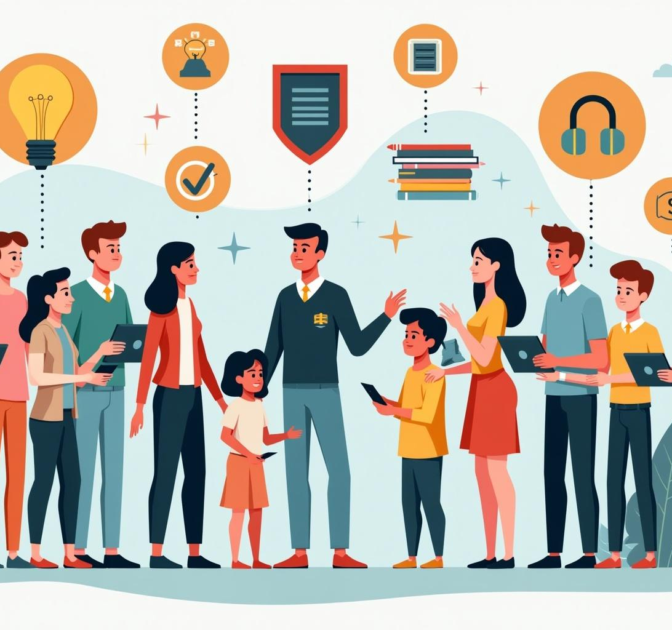
Conclusion & Recommendations
Integrate digital literacy across curricula, provide targeted teacher training, and allocate resources for student access to tools.
Prioritize ethical use and safety education to prepare students for academic success and responsible digital citizenship.

Slide 11

Conclusions
Digital literacy is essential for student success in 2026 and beyond.
Implement curriculum integration, training, and policy to ensure skills, safety, and ethical awareness are consistently developed.

Slide 12
Thanks! Any Questions?

